Slide 1
E-R Conversion into Tables
Rushali Patil

Slide 2
Representation of Strong Entity Sets With Simple Attributes
A strong entity set with only simple attributes will require only one table in relational model.
Attributes of the table will be the attributes of the entity set
The primary key of the table will be the key attribute of the entity set.

Slide 3
Representation of Strong Entity Sets With Simple Attributes
Relation Schema
employee (EID, name, desig, dept, DoB)
Table : Employee
EID
Employee
Designation
Name
Department
DoB
EID | Name | Desig | Dept | DoB

Slide 4
Representation of Strong Entity Sets With Composite Attributes
A strong entity set with any number of composite attributes will require only one table in relational model.
While conversion, simple attributes of the composite attributes are taken into account and not the composite attribute itself.

Slide 5
Representation of Strong Entity Sets With Composite Attributes
EID
Employee
Designation
Relation Schema Relational Schema
employee (EID, name, desig, dept, bname, street, city)
Table : Employee
Name
Department
Address
Building Name
City
Street
EID | name | desig | dept | bname | street | city

Slide 6
Strong Entity Set With Multi Valued Attributes
A strong entity set with any number of multi valued attributes will require two tables in relational model
One table will contain all the simple attributes with the primary key
Other table will contain the primary key and all the multi valued attributes

Slide 7
Strong Entity Set With Multi Valued Attributes
ContactNo
Employee
Relation Schema Relational Schema
employee (EID, name, desig, dept)
emp_phone(EID, contact_no)
Table : Employee Emp_phone
EID
Designation
Name
Department
EID | name | desig | dept
EID | Cnotact_no

Slide 8
Representation of Weak Entity Set
Let B be a weak entity set with attributes b1,b2,….bn and A be strong entity set on which B depends. Let the primary key of A consists of attributes a1, a2,…an.
Weak entity set schema is B with one attribute of for each member is represented as:
{b1,b2,…bn} U {a1, a2,…an}
For this schema primary key will be primary key of strong entity and discriminator of weak entity set

Slide 9
Representation of Weak Entity Set
Primary Key
Discriminator
E-ID and Dname together identify weak entity set Dependents.
E-ID
Ename
Dname
Age
Employee
Has
Dependents
Dept
Relationship

Slide 10
Representation of Weak Entity Set
Relation Schema
emp(EID, ename, dept)
dependents (EID, dname, age, relationship)
Table : Dependents
EID | dname | age | relationship

Slide 11
Representation of Relationship Set
A relationship set will require one table in the relational model
Attributes of the table are-
Primary key attributes of the participating entity sets
Its own descriptive attributes if any
Set of non-descriptive attributes will be the primary key

Slide 12
Representation of Relationship Set
Bname
Author
PID
Publishing_ Date
pname
Relation Schema
published_by (PID,bname, publishing_date)
Table : Published_By
Book
Published By
Publisher
PID | Bname | Publishing_date

Slide 13
Tables in ER diagram
Bname
Author
Publishing_ Date
PID
pname
Relation Schema
book(bname, author)
published_by (PID,bname, publishing_date)
publisher (PID, pname)
Table : Book Published_By Publisher
Book
Published By
Publisher
PID | Bname | Publishing_date
PID | Pname
Bname | Author

Slide 14
The Primary Key Selection For Binary Relationship Sets
Many-to-Many: Primary Key->The union of primary key attributes from the participating entity sets
One-to-One: Primary Key->The primary key of either entity set can be chosen (arbitrarily)
Many-to-One/ One-to-Many : Primary Key->The primary key attributes of the entity set on “many” side
n-ary relationship set without arrows on the edges: Primary Key->The union of primary key attributes from the participating entity sets
N-ary relationship set with an arrow on one of its edge: Primary Key->The primary key attributes of the entity sets not on the “arrow” side of the relationship set

Slide 15
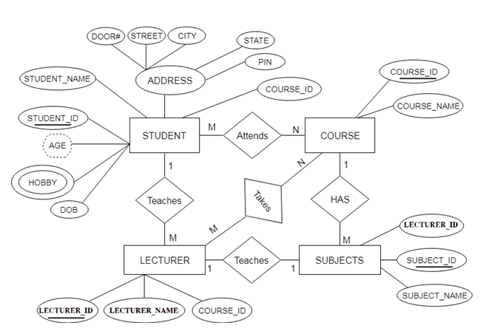
Example 1

Slide 16
Answer
student(SID, sname, DoB, courseID, door#, street,city, state , pin)
stud_hobby(SID, hobby_name)
course(courseID, cname)
lecturer(l-ID, lname, courseID, subID,SID)
subjects(subID, sname, l-ID,courseID)
attends(SID, courseID)
takes(l-ID, courseID)
teaches(l-ID, SID)
has(subID, courseID)
teaches1(l-ID, subID)

Slide 17
Final Answer
student(SID, sname, DoB, courseID, door#, street,city, state , pin)
stud_hobby(SID, hobby_name)
course(courseID, cname)
lecturer(l-ID, lname, courseID, subID,SID)
subjects(subID, sname, l-ID,courseID)
attends(SID, courseID)
takes(l-ID, courseID)

Slide 18
Exapmle 2 E-R For Sports Team
Age
MatchID
TeamID
Name
Date
Location
Played
n
Match
1
Player
Opponent Team
Oppo_Score
Individual_Score
Own_Score
Score

